Slide 1
VHDL PONG GAME
DIGITAL SYSTEMS DESIGN 2024
Jan Juraszek, Max Peseux, Dimitri Pelgrin, Group R

Slide 2
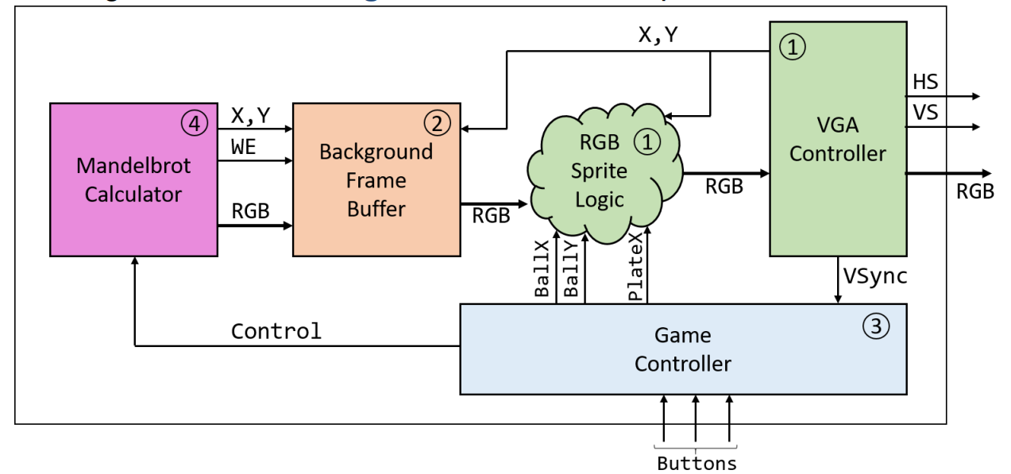
Project architecture
The suggested project architecture has been successfully implemented.

Slide 3
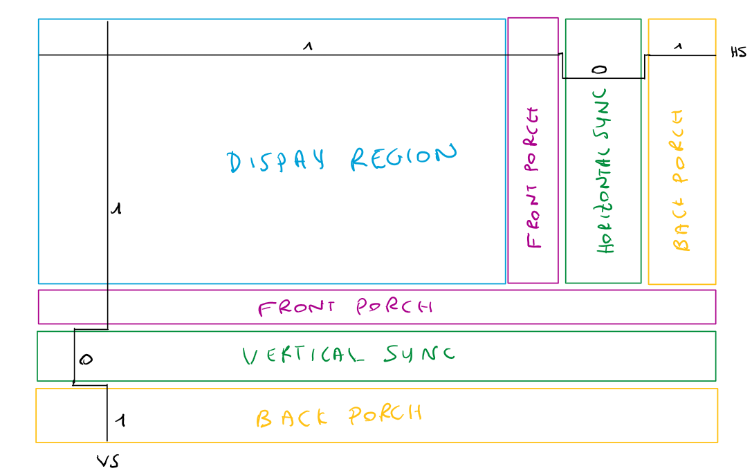
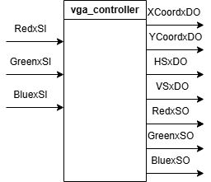
VGA controller
Vertical and horizontal pulse synchronisation
Porches and sync delays
Counters for (X,Y) iterations
Adequate color output

Slide 4
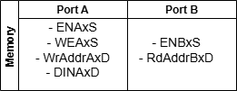
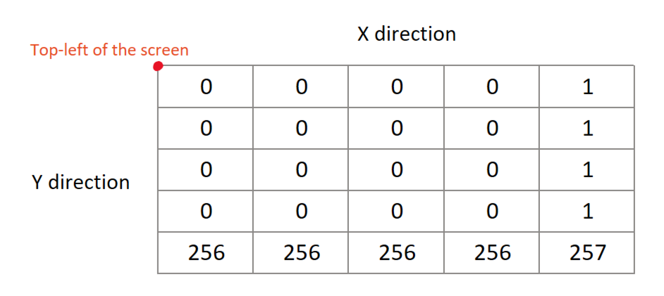
Memory
Port A:
Enable signals dictated by the Mandelbrot algorithm;
Writing in memory given limited memory space
Input data correspond to Mandelbrot iterations output;
Port B:
Always enabled
Reading from memory given limited memory space
Mapping of the top-left pixels in memory
The numbers provided correspond to the memory address allocated to each pixel
Mathematical operation: Addr=(X/4)+(Y/4)*256
Note: Division by 4 is simply a 2-bit right shift

Slide 5
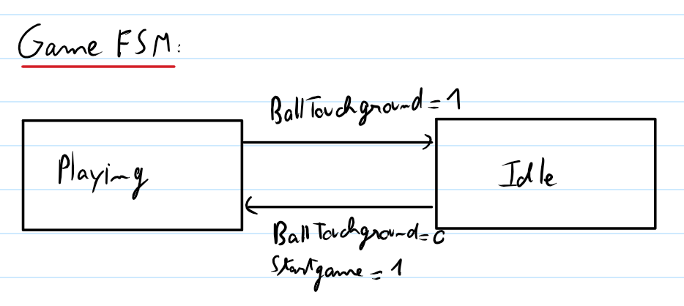
Pong game logic
The game FSM with only two states

Slide 6
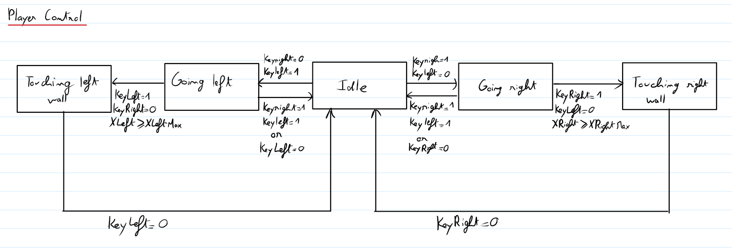
Pong game logic
The player FSM implemented using when/else structure

Slide 7
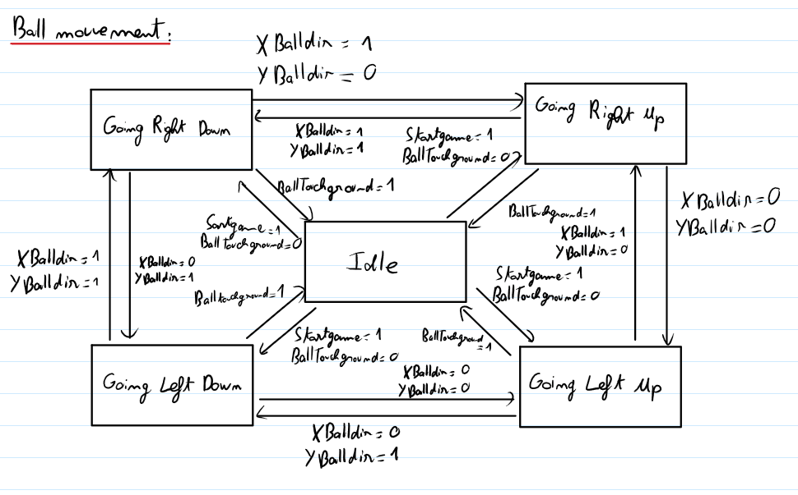
Pong game logic
The ball FSM implemented using when/else structure

Slide 8
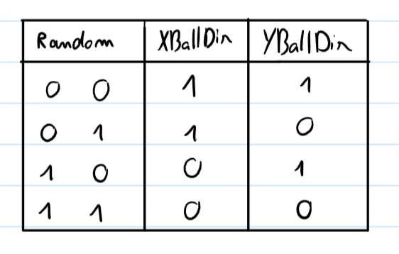
Pong game logic
The truth table for the direction of the ball at start according to the value of the counter Random.

Slide 9
Mandelbrot
Truncation logic:
Large intermediate multiplication signals reduced to Q3.15 format
Entry condition sum reduced to Q6.15 for adequate comparison with MAX_ITER
End of screen conditions
In memory:
Mandelbrot (X,Y) control writing
VGA Controller (X,Y) control reading
--Intermediate multiplications for the Mandelbrot algorithm
MULRE <= Z_RExDP * Z_RExDP; --Q6.30
MULIM <= Z_IMxDP * Z_IMxDP; --Q6.30
MULREIM <= Z_RExDP * Z_IMxDP; --Q6.30
--Truncated results to match signal sizes
MULRE_TRUNC <= MULRE(2*N_BITS-3-1 downto N_BITS-3); --Q3.15
MULIM_TRUNC <= MULIM(2*N_BITS-3-1 downto N_BITS-3); --Q3.15
MULREIM_TRUNC <= MULREIM(2*N_BITS-3-1 downto N_BITS-3); --Q3.15
--Entry condition truncation
SUM_MULREIM <= MULRE + MULIM;
SUM_MULREIM_TRUNC <= SUM_MULREIM(SUM_MULREIM'length-1 downto N_frac); --Q6.15

Slide 10
Top level implementation + extras
Second memory block made for “scrolling” mandelbrot
  Identical to the first one
Memory:
  Writing from mandelbrot twice and reading data output twice
    The second memory is read with a horizontal offset based off a counter to shift the image sideways
Color selection:
  Display scrolling mandelbrot colours if inside static mandelbrot “empty” area, i.e. when the iterations count equals 100.
  Mandelbrot colour decided by truncating the iteration count across RGB channels
Ball/palette drawing
  Decide to draw ball/palette or background dependent on the position of them and the current display coordinates

Slide 11
Conclusion
Potential improvements:
Sprites incorporation
Score display
Biggest challenges faced:
Pong Finite State Machine implementation: avoiding latches and synchronizing signals
Mandelbrot truncations: correct use of fixed-point arithmetic
Memory allocation: adequate use of limited memory resources

